Slide 1


LBR-5 : STRUCTURAL ANALYSIS
ANAST Naval Architecture and Transport Systems Analysis
UNIVERSITY OF LIEGE

Slide 2
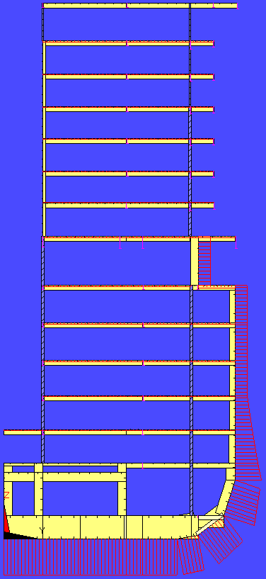
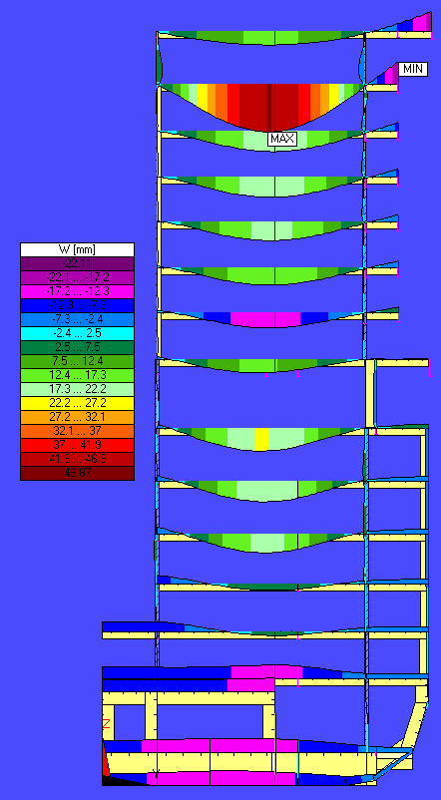
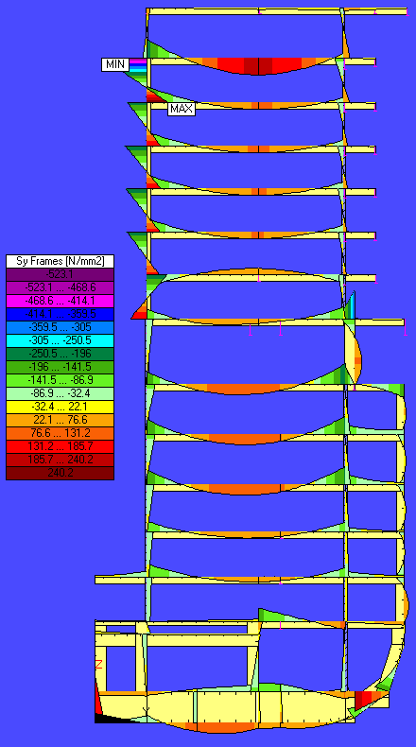
LBR5 – Structural Analysis
How is performed the structural analysis in LBR5?

Slide 3
LBR5 – Structural Analysis
Overview
Differential equations of cylindrical stiffened shells
Stiffened cylindrical shell (plate) elements
Analytical solution for the governing equations of stiffened panels
  Homogeneous solution (or complementary solution)
  Fourier series expansion
  Loads’ Fourier series expansion
  Homogeneous solution of differential equations
  Basic unitary load lines
  Actual panels
Conclusions

Slide 4
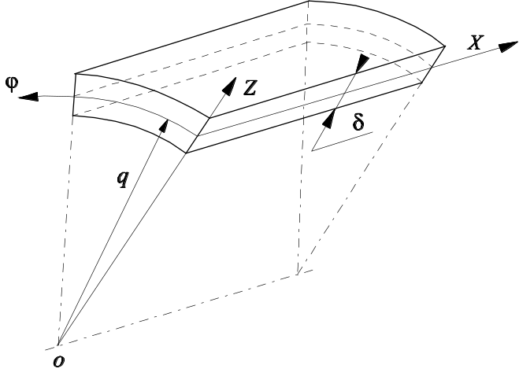
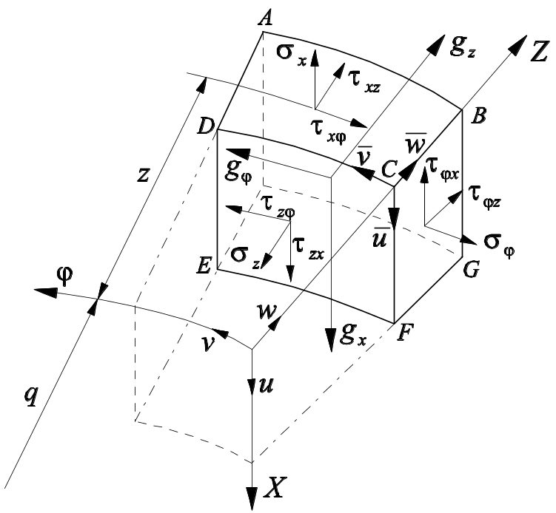
LBR5 – Differential Equations of Cylindrical Stiffened Shells
Generalities
z = 0 at mid plate thickness
y = q ϕ
with ϕ used for shell and y used for plate
small volume element [dx, (q+z)dϕ, dz]
Displacements u, v, w and stresses σ, τ
Love-Kirchoff hypotheses, i.e.
  Thin shell theory (δ/q <<< 1)
  Small deformation and linear analysis
  Section plane conservation
  (γ_{xz} = γ_{ϕz} = 0 ⇒ τ_{xz} = τ_{ϕz} = 0)
  σ_{z} and its effects are negligible
  No deformation along oz (ε_{z} = 0)

Slide 5

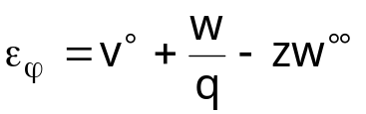
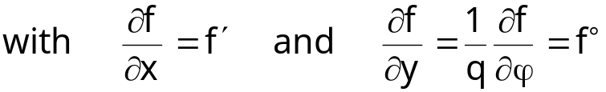

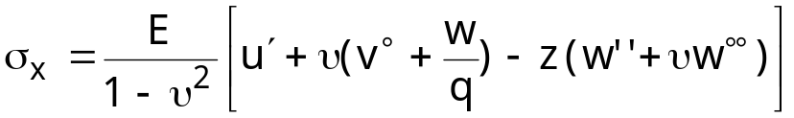
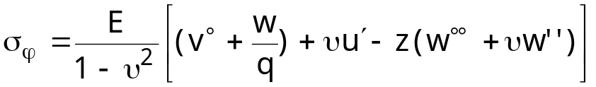

LBR5 – Differential Equations of Cylindrical Stiffened Shells
‘Deformation-displacement’ relationships for shell
‘Stress-displacement’ relationships for shell
with E = Young modulus = 2.1 10⁵ MPa for steel
υ = Poisson coefficient = 0.3 for steel
G = shear modulus = 8.1 10⁴ MPa for steel

Slide 6
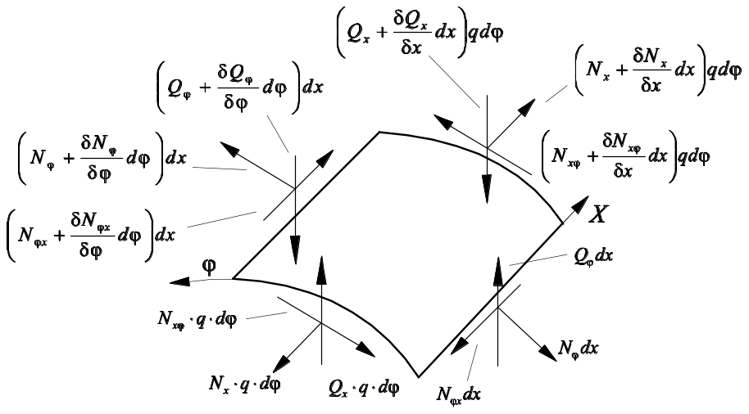
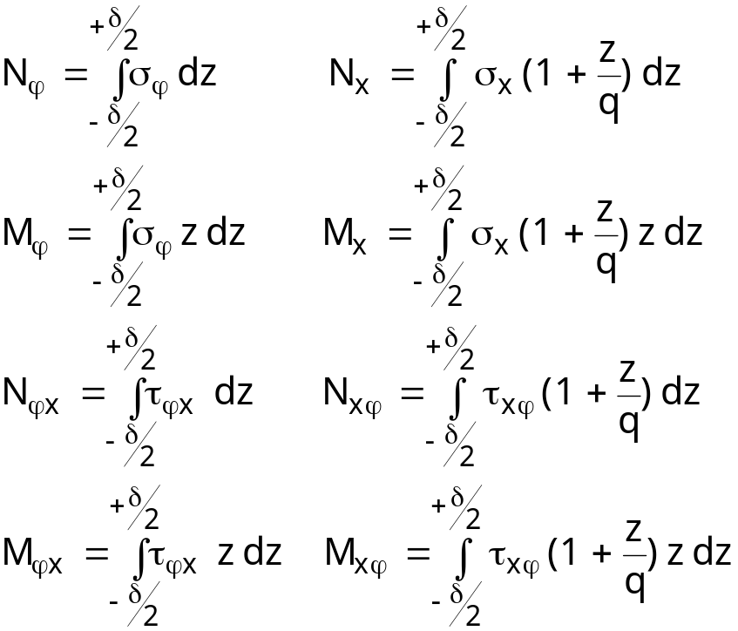
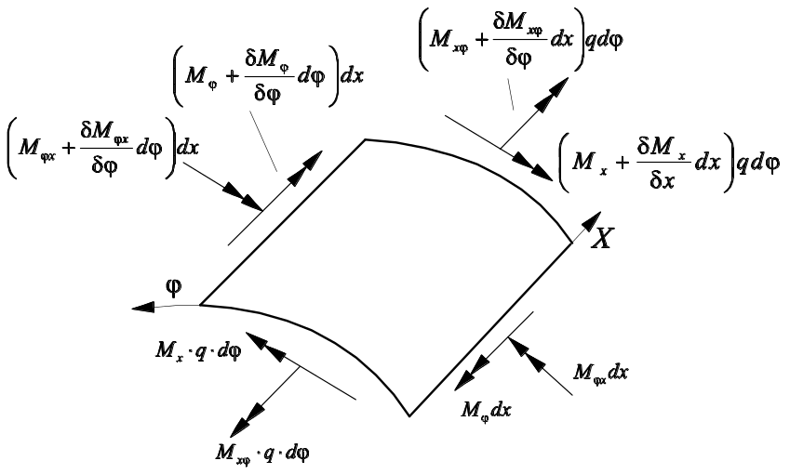
LBR5 – Differential Equations of Cylindrical Stiffened Shells
‘Resultant-stress’ relationships for shell
Small volume element [dx, qdϕ, δ]
Reference = plate neutral axis (z = 0)

Slide 7
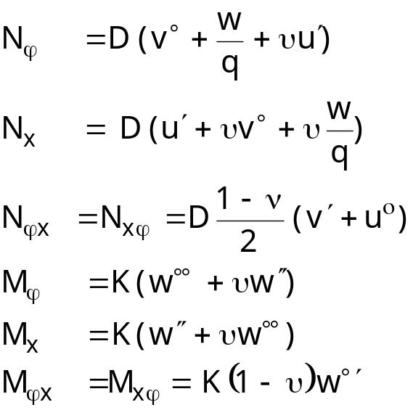
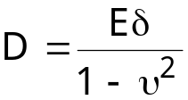
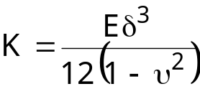
LBR5 – Differential Equations of Cylindrical Stiffened Shells
‘Resultant-displacement’ relationships for shell
‘Stress-displacement’ relations + ‘Resultant-stress’ relations
with

Slide 8
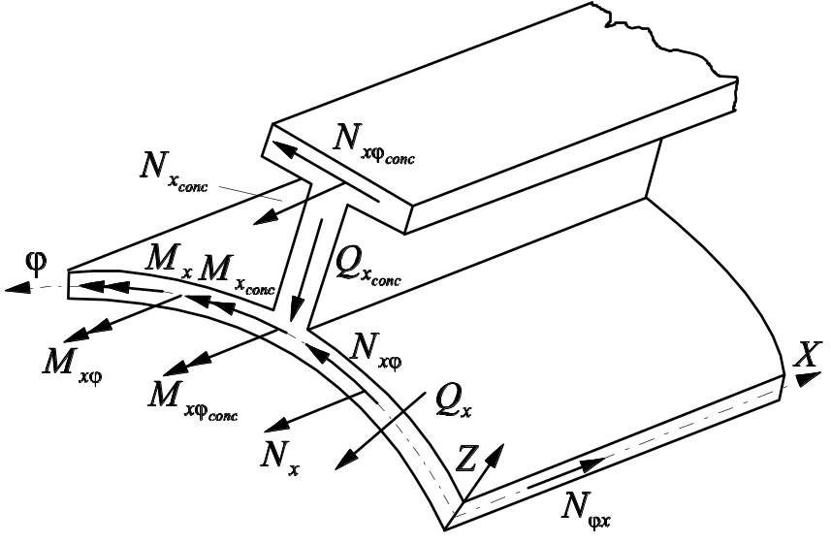
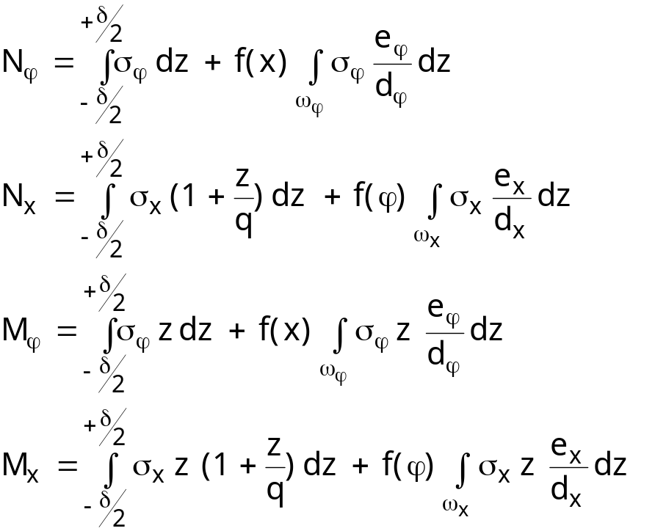
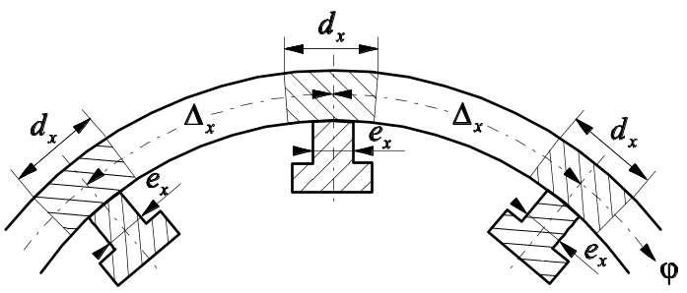
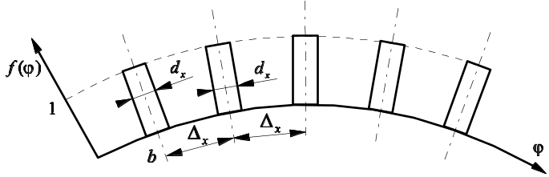
LBR5 – Differential Equations of Cylindrical Stiffened Shells
‘Resultant-stress’ relationships for stiffened shell
Additional resultant forces coming from the stiffeners
with ω_{x} = cross-section of the stiffener
ω_{ϕ} = cross-section of the frame

Slide 9
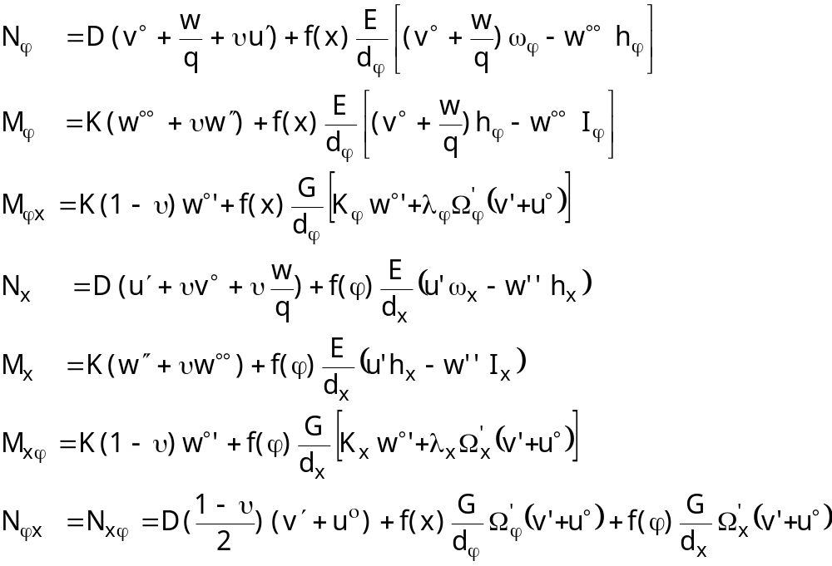
LBR5 – Differential Equations of Cylindrical Stiffened Shells
‘Resultant-displacement’ relationships for stiffened shell

Slide 10
LBR5 – Differential Equations of Cylindrical Stiffened Shells
‘Resultant-displacement’ relationships for stiffened shell
with ω_{x}, ω_{ϕ} = cross-section of a stiffener (frame) without plating
h_{x}, h_{ϕ} = 1st sectional moment of ω_{x} (ω_{ϕ}) about the plate neutral axis
I_{x}, I_{ϕ} = 2nd sectional moment of ω_{x} (ω_{ϕ}) about the plate neutral axis
K_{x}, K_{ϕ} = torsional rigidity of a stiffener (frame)
Ω_{x}’, Ω_{ϕ}’ = reduced flange section (for flange in-plane shear contributing)
λ_{x}, λ_{ϕ} = flange excentricity to the plane neutral axis
d_{x}, d_{ϕ} = effective strip width of stiffeners (frames)
Note: In LBR5, no flange in-plane shear contributing ⇒ Ω_{x}’ = Ω_{ϕ}’ = 0

Slide 11
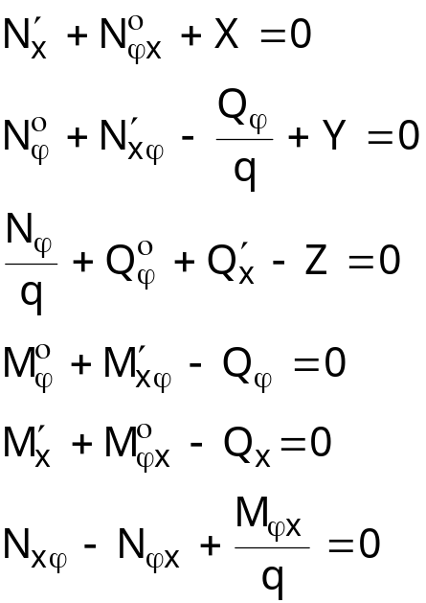
LBR5 – Differential Equations of Cylindrical Stiffened Shells
Equilibrium equations
with X, Y, Z = external pressures

Slide 12
LBR5 – Differential Equations of Cylindrical Stiffened Shells
Governing differential equations of cylindrical stiffened shell
13 unknows
u, v, w
N_{x}, M_{x}, Q_{x}, N_{xϕ}, M_{xϕ}
Nϕ, Mϕ, Q_{x}, N_{ϕx}, M_{ϕx}
13 equations
Equilibrium equations (6-1=5)
‘Resultant-displacement’ relationships for stiffened shell (8)
⇒ 3 governing differential equations of stiffened shell in u, v, w

Slide 13
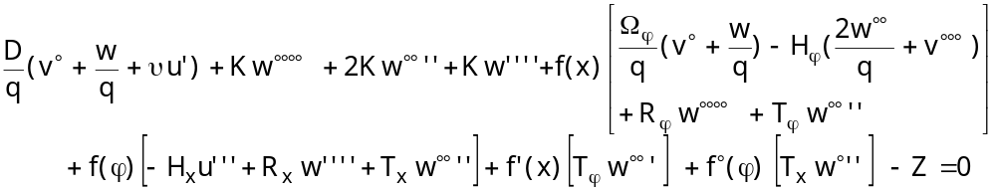
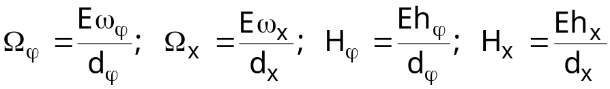
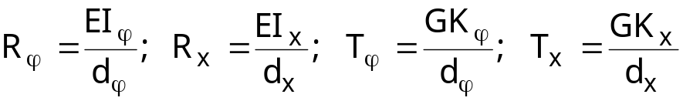
LBR5 – Differential Equations of Cylindrical Stiffened Shells
Governing differential equations of cylindrical stiffened shell
with
shell → plate if q → ∞

Slide 14
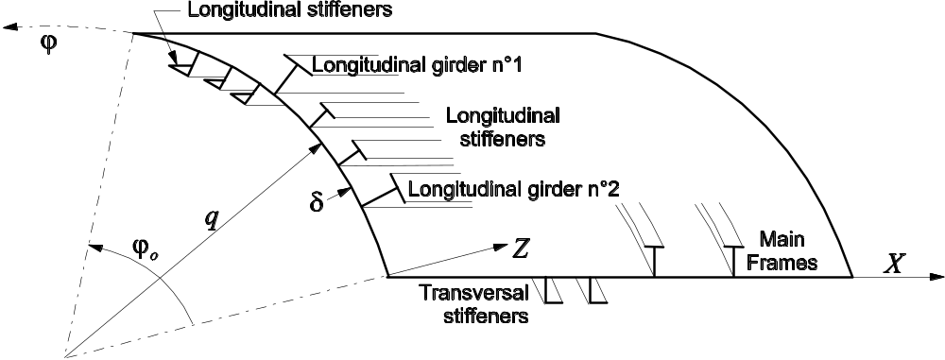
LBR5 – Stiffened Cylindrical Shell Elements
Generalities
Plating (δ) + 2 layers of stiffeners
Stiffeners along ox = longitudinal stiffeners
Stiffeners along oϕ = transverse frames
Assumption : stiffeners and frames from a same element are identical and have the same spacing

Slide 15
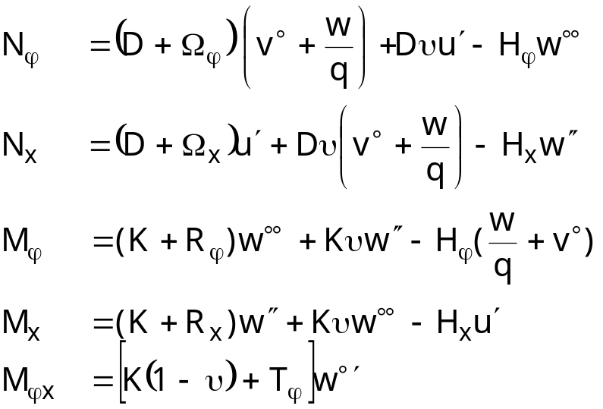

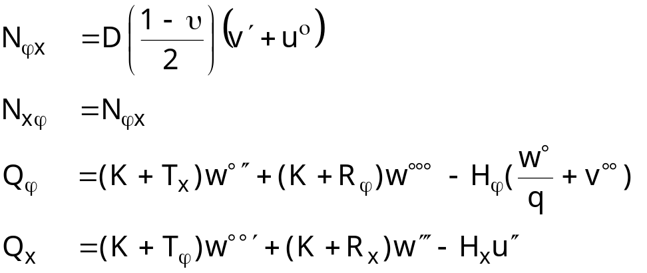
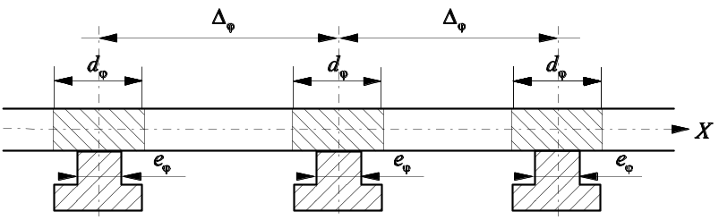
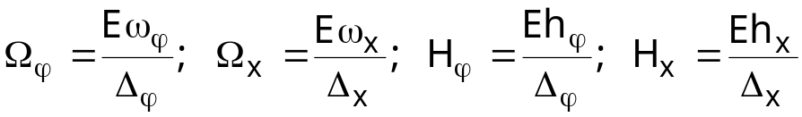
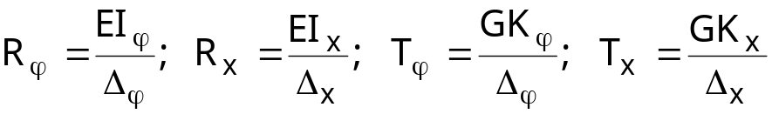
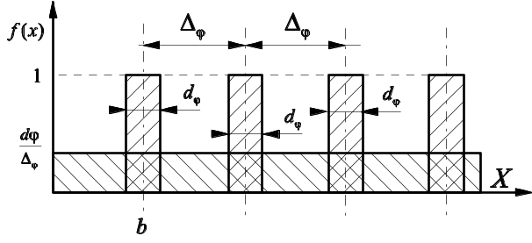
LBR5 – Stiffened Cylindrical Shell Elements
Resultant forces and moments of two-layered stiffened panels
with
Accurate global stiffened panel behavior

Slide 16
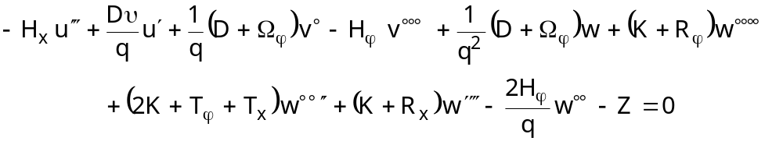
LBR5 – Stiffened Cylindrical Shell Elements
Governing equations of two-layered stiffened panels
shell → plate if q → ∞

Slide 17
LBR5 – Analytical for the Governing Equations of Stiffened Panels
Generalities
3 coupled differential equations to be solved simultaneously
Equivalent system of equations :
a₁u + b₁v + c₁w = +X(x,ϕ)
a₂u + b₂v + c₂w = +Y(x,ϕ)
a₃u + b₃v + c₃w = -Z(x,ϕ)
with u(x,ϕ), v(x,ϕ), w(x,ϕ) = displacements
x, ϕ = coordinates of a point at mid-plate of the cylindrical shell
X(x,ϕ), Y(x,ϕ), Z(x,ϕ) = surface loads
a₁, b₁, …, c₃ = the derivative operators

Slide 18
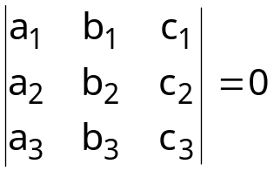
LBR5 – Analytical for the Governing Equations of Stiffened Panels
Homogeneous solution (or complementary solution)
Homogeneous solution of the governing differential equations yields:
⇔ a₁ (b₂c₃ + b₃c₂) + a₂ (b₃c₁ - b₁c₃) + a₃ (b₁c₂ - b₂c₁) = 0
Application of this operator to w(x,ϕ) displacement
8th order differential equations with 2 coupled variables x, ϕ
w_{ij} = i^{th} order derivative of w by x and j^{th} order derivative by y

Slide 19
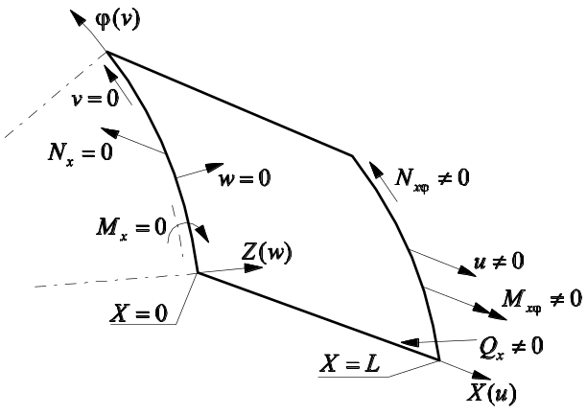
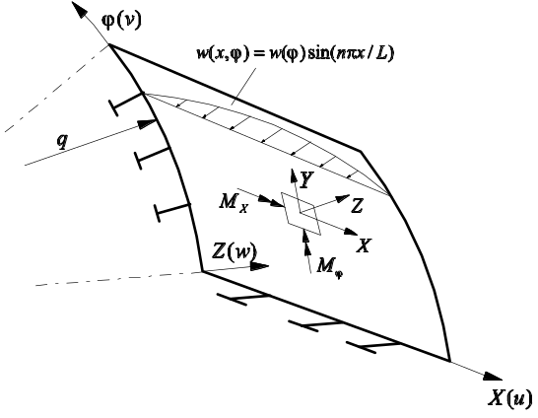
LBR5 – Analytical for the Governing Equations of Stiffened Panels
Fourier series expansion
Assumption on the shape of the displacements u, v, w
u(x,ϕ) = u(ϕ) ∑ cos(λx)
v(x,ϕ) = u(ϕ) ∑ sin(λx)
w(x,ϕ) = w(ϕ) ∑ sin(λx)
with λ = nπ / L
n = term number of the Fourier series expansion
L = span of the structure along ox (same L for each panel)
Limitations on the boundary conditions : edges (x = 0, x = L) ≡ simple support

Slide 20
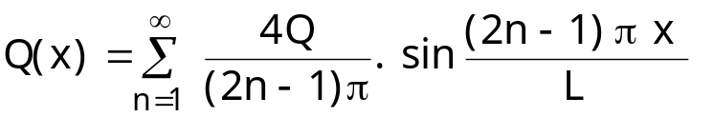
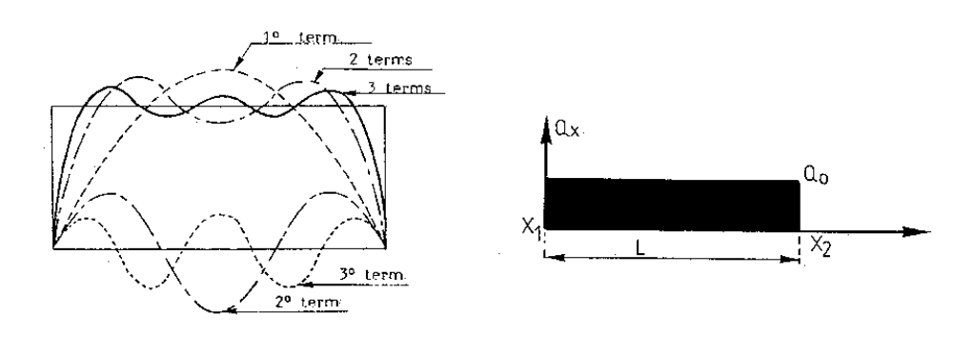
LBR5 – Analytical for the Governing Equations of Stiffened Panels
Loads’ Fourier series expansions
Z(x,ϕ) loads have to satisfy Fourier series expansion’s shapes
Z(x,ϕ) = Z*(ϕ) Q(x) = Z*(ϕ) ∑ [a sin(λx)]
Hydrostatic pressure = uniformly distributed along ox and linear along oϕ
Expansion along ox :

Slide 21
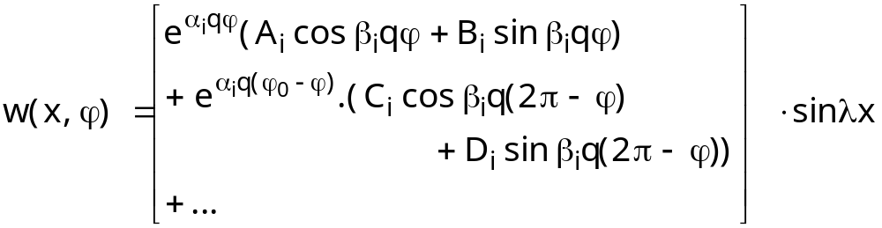
LBR5 – Analytical for the Governing Equations of Stiffened Panels
Homogeneous solution of differential equations
with A_{i}, B_{i}, C_{i}, D_{i} = integration constants
A_{i}, B_{i}, C_{i}, D_{i} determined trough boundary and symmetry conditions
Note: similar equations for u(ϕ), v(ϕ) depending on A_{i}, B_{i}, C_{i}, D_{i}
w(ϕ) → u(ϕ), v(ϕ) → N, M, Q

Slide 22
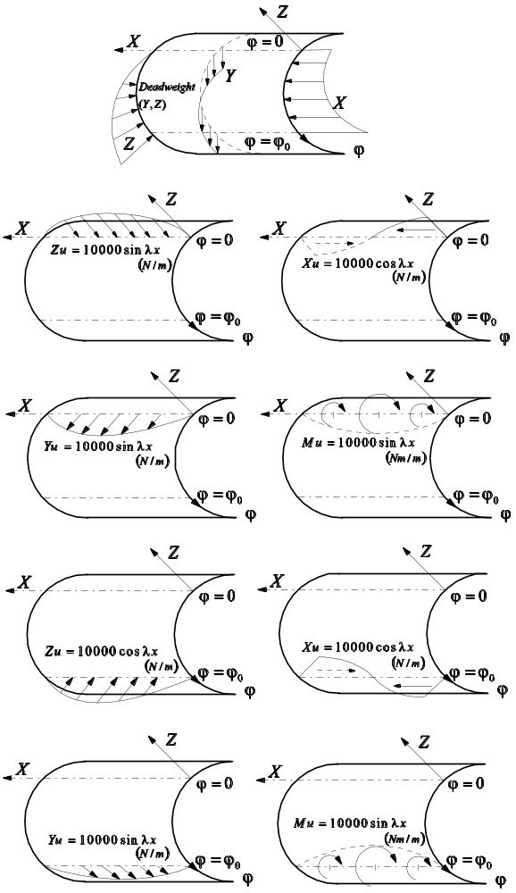
LBR5 – Analytical for the Governing Equations of Stiffened Panels
Basic unitary load lines (complete cylinder)
4 basic unitary load lines applied at ϕ = 0
X_{u} = 10000 cos(λx) (N/m)
Y_{u} = 10000 sin(λx) (N/m)
Z_{u} = 10000 sin(λx) (N/m)
M_{u} = 10000 sin(λx) (Nm/m)
For each unitary load line, integration constants A_{i}, B_{i}, C_{i}, D_{i} obtained trough boundary conditions at ϕ = 0 and ϕ = 360°, and symmetry conditions
Lateral pressure → integration of the basic load lines’ solutions

Slide 23
LBR5 – Analytical for the Governing Equations of Stiffened Panels
Actual panels (actual shell opening angle ϕ₀)
4 basic unitary load lines applied at ϕ = 0 and ϕ = ϕ₀ (X_{u}, Y_{u}, Z_{u}, M_{u})
For each panel, 8 unknowns = edge amplification factors of the load lines
Boundary conditions in ϕ = 0 and ϕ = ϕ₀
  For a free edge : M_{ϕ} = N_{ϕ} = N_{xϕ} = R_{ϕ} = 0
  For a clamped edge : w = v = u = w° = 0
  For a simply supported edge : w = u = M_{ϕ} = N_{ϕ} = 0
  For a junction between 2 panels : 4 compatibility and 4 equilibrium equations
  For a junction between 3 panels : 8 compatibility and 4 equilibrium equations
System 8N x 8N with N number of panels

Slide 24
LBR5 – Analytical for the Governing Equations of Stiffened Panels
Conclusions
LBR5 structural analysis = analytical method
Resolution of the stiffened panels differential equations
Using of Fourier series expansion
Fast and accurate linear elastic analysis ⇒ suitable for structural optimization
Limitations
  Analysis of prismatic (cylindrical) structure
  Fourier series expansion’s shapes for the displacement ⇒ ‘pin-pin’ beam

